Slide 1


JAVA SE
(Core java)
Lecture 5

Slide 2

Today’s Agenda
Basic Concepts In Java
Data Types
Type Conversion
Implicit Type Conversion
Explicit Type Conversion
Type Conversion In Expressions

Slide 3
Data Types
Generally, data types are used to create variables where variables will hold values, as defined in the range of values of a data type.
Java supports two categories of data types:
Primitive data types and
Non Primitive Data Types

Slide 4
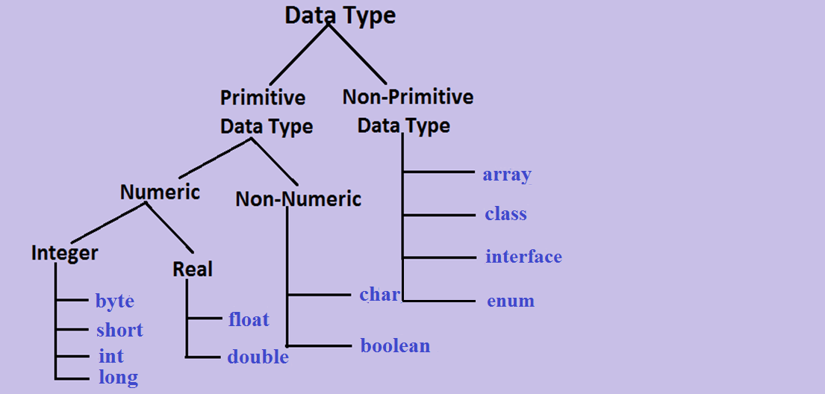
Data Type Categories

Slide 5
Non Primitive Data Types
Non primitive data types are also called as reference data types
A Non Primitive Data Type is used to refer to an object.
In Java , variables of type class , arrays , enums and interface are represented as objects.
We will discuss this in later chapters like Arrays and Classes and Objects

Slide 6
Primitive Data Types
There are totally eight primitive data types in Java. They can be categorized as given below:
Integer types (Does not allow decimal places)
byte
short
int
long
Rational Numbers(Numbers with decimal places)
float
double
Characters
char
Conditional
boolean

Slide 7
Primitive Data Types
Integer Types
Type | Size (In Bytes) | Range
byte | 1 | -128 to 127
short | 2 | -32768 to 32767
int | 4 | -2147483648 to 2147483648
long | 8 | -9223,372,036,854,775,808 to 9223,372,036,854,775,807

Slide 8
Primitive Data Types
Rational Numbers
Type | Size (In Bytes) | Range
float | 4 | -3.4 * 10³⁸ to 3.4 * 10³⁸ (6 significant decimal digits)
double | 8 | -1.7*10³⁰⁸ to 1.7*10³⁰⁸ (15 significant decimal digits)

Slide 9
Primitive Data Types
Characters
Type | Size | Range
char | 2 | 0 to 65535

Slide 10
Primitive Data Types
Why Java uses 2 bytes for characters ?
In Java almost 61 international languages are supported .
Now, the characters and symbols of these languages cannot be accommodated in 1 byte space in memory ,so Java takes 2 byte for characters.
Java supports UNICODE but C language supports ASCII code. In ASCII code we can represent characters of English language, so for storing all English latter and symbols 1 byte is sufficient.

Slide 11
Primitive Data Types
But UNICODE character set is superset of ASCII in which all the characters which are available in 61 international languages are supported and it contains 65536 characters ranging from 0 to 65535
To assign UNICODE values we have two options:
Use the numeric value
OR
Use the format ‘\uxxxx’ where xxxx is hexadecimal form of the value
For example:
char ch=65;
OR
char ch=‘\u0041’;
Both means we are assigning letter A

Slide 12
Primitive Data Types
Conditional
Type | Size | Range
boolean | JVM Dependent | true or false

Slide 13
Type Conversion
What is type conversion ?
Whenever the compiler encounters a statement where the value on right side of assignment is different than the variable on left , then the compiler tries to convert R.H.S to L.H.S and this automatic conversion done by compiler is called as Type Conversion.

Slide 14
Type Conversion
For example:
Consider the following statement:
x = y;
In this case two things might happen:-
1 . If data type of both variables are same then value of y
will be assigned to the variable x.
2. But if data type of both variables are different then the value of y needs to be converted as per the data type of variable x and this is called “Type Conversion”

Slide 15
Type Conversion
Forms Of Type Conversion
In Java ,type conversion is of two types
Implicit Conversion
( automatically done by compiler)
Explicit Conversion
( specially done by programmer , also called Type Casting)

Slide 16
Rules For Implicit Conversion
For implicit conversion there are 2 conditions which must be true :
The values must be compatible/convertible.
AND
The value on RHS of assignment must be smaller than variable on LHS
If both these rules are followed then Java will implicitly
convert the value otherwise conversion has to be done by the
programmer
Let us understand them in depth

Slide 17

Rule 1 : Convertible
Convertible means it must be possible for Java to convert a value from one form to another.
For example , it is possible for Java to convert a character to an integer using it’s UNICODE/ASCII value .
So the following will compile:
int x=‘A’;
But it is not possible for java to convert the boolean value “true” to integer as the values “true” and “false” have no other representation.
So the following statement will not compile:
int x=true;

Slide 18
Rule 2 : Smaller
Smaller means the range of a variable’s data type must be a smaller than other variable’s range. NOT THE SIZE
For example , a short data type variable has a range of -32768 to 32767 which is smaller( proper subset) of the range of an int variable whose range is -2147483648 to 2147483647, so “short” is considered to be smaller than an “int”.
Another example, an int is of 4 bytes and has a range of
-2147483648 to 2147483647 while a float is also of 4 bytes but has a range of -3.4*10³⁸ to 3.4 *10³⁸ which is greater than the range of int , so int is smaller than float.

Slide 19
QUIZ
Is a long data type smaller than float ?
Yes
No
Because the range of long is smaller than range of a float.

Slide 20




Examples
1. byte a=10;
int b;
b=a;
because [range of int > byte]
2. int a=10;
byte b;
b=a;
because [range of byte<int] ------------lossy conversion
b=(byte)a; you have to do explicit conversion
3. int a=128;
byte b;
b=a;
because ---[ range of int>byte]
b= (byte)a; [b will become -128 as here after type conversion, rotation will take place]

Slide 21


Examples
4. short a=10;
int b;
b=a;
because range of [short<int]
5. int a =10;
short b;
b=a;
because range of [int>short]
b=(short)a;
(you have to do explicit conversion)
6. int a=32768;
short b;
b=a;
b=(short)a;
But yet value is also out of range java does rotation and assign the value -32768 to the variable b

Slide 22



Examples
7. int a=10;
long b;
b=a;
because range wise [long >int] so, its correct.
8. long a=10;
int b;
b=a;
because long value can’t assign to int , it’s an error
b=(int)a;
you have to do explicit conversion.
9. long a=2147483648;
int b;
b=a;
because if any integer constant crosses the range of int data type then it has no meaning for java compiler.
long a=2147483648L;
int b;
b=a;
because long is assigned to integer so,error: lossy conversion.
b=(int)a;
value is out of range so, compiler rotates it’s values(-2147483648)
error: value too large to be represented as integer

Slide 23
Examples
10. byte a=10;
char b;
b=a;
because range wise char is not > than byte as char starts from 0 and byte starts from -128.
11. char a=‘x’;
byte b;
b=a;
because range wise byte is not > than char as byte ends at 127 while char ends at 65535
12. short a=10;
char b;
b=a;
because range wise char is not > than short as char starts from 0 and short starts from -32768.
13. char b=‘x’;
short a;
a=b;
because range wise short is not > than char as short ends at 32767 while char ends at 65535.
14. int a=10;
char b;
b=a;
because range wise char is smaller than int.
15. char b=‘x’;
int a;
a=b;
because range wise int is > than char

Slide 24

Examples
16. double a=1.7;
float b;
b=a;
because [double>float] possible loss of precision.
b=(float)a;
17. float a=1.7;
because every decimal constant by default is a double and
double is > than float .
Solution is to suffix it with f or F
18. float a=1.7f;
double b;
b=a;

Slide 25
Examples
19. boolean a=true;
int b;
b=a;
20. boolean a=true;
int b;
b=a;
21. int a=1;
boolean b;
b=(boolean)a;
22. int a=1;
boolean b;
b=(boolean)a;
Error Message :- Incompatible Types
because boolean cannot be converted into any type implicitly or explicitly.

Slide 26
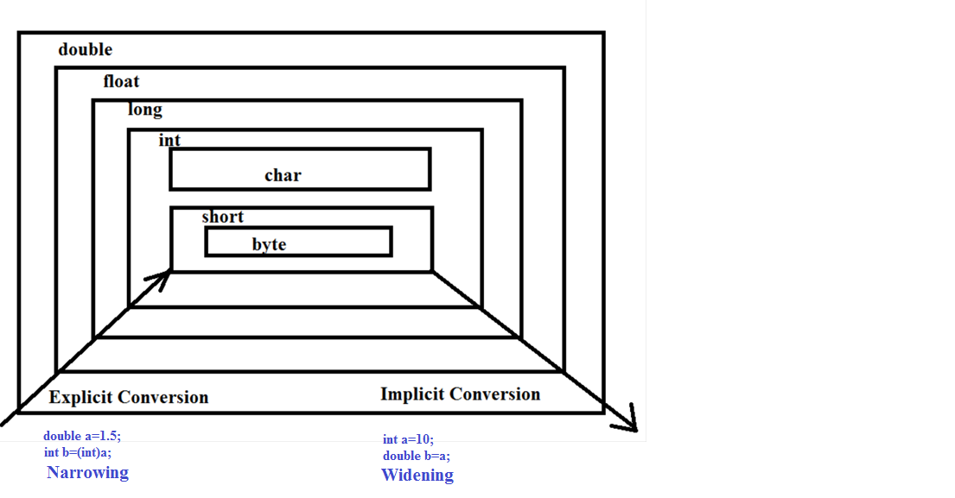
Conversion Diagram

Slide 27
Type Conversion In Expression
Previous type conversion is called type conversion in assignment.
Java follows another type conversion called type conversion in expression.
Java follows this rule in arithmetic expressions and converts a lower type value to higher type as per the operands involved
byte
short
char int
int long long
float float
double double

Slide 28


Type Conversion In Expression
byte a=10,b=20;
byte c
c = a + b;
possible loss of precision. [byte < int]
because both a and b are bytes java converts them to int
Sol:-1
c=(byte)(a+b);
not reliable as byte is < int so there maybe rotation of value.
Sol:-2
byte a=10,b=20;
int c;
c=a+b; more reliable

Slide 29
QUIZ
Which of these is necessary condition for automatic type conversion in Java?
A. The destination type is smaller than source type.
B. The destination type is larger than source type.
C. The destination type can be larger or smaller than source
type.
D. None of the mentioned.
Answer:-B

Slide 30
QUIZ
What is the error in this code? byte b = 50; b = b * 50;
A. b can not contain value 2500, limited by its range.
B. * operator has converted b * 50 into int, which can not be converted to byte without casting.
C. b can not contain value 50.
D. No error in this code.
Answer:-B

Slide 31
QUIZ
If an expression contains double, int, float, long, then whole expression will promoted into which of these data types ?
A. long
B. int
C. double
D. float
Answer:-C

Slide 32

End Of Lecture 4
For any queries mail us @: scalive4u@gmail.com
Call us @ : 0755-4271659, 9826086245
Agenda for Sixth Lecture:
Operators
Displaying values of variables
Concatenation using operator +
Concept of default values
Program to calculate area and circumference of Circle

